Slide 1
Logic and Proof
Lecture 2
Discrete Mathematical Structures

Slide 2
At the Last Class …
Part I: Sets, Sequences and Structures
  Sets: fundamental model in mathematics
  Sequences: elements and order
  Structures: sets with operations
Part II: Some Useful Tools
  Division, prime and algorithm
  Matrices and operations on them

Slide 3
Logic and Proof
Part I: Propositional and Predicate Logic
  Logical operations and truth tables
  Quantifiers
  Logic statements
Part II: Methods of Proof
  Rules of inference
  Indirect method of proof
  Proof by contradiction
  Disproving by counterexamples

Slide 4
Soduku
5
4
2
3
9
？
3,6
8
9
5
9
7
4
7
3
2
1
5
9
2
4
1
8
1
6
1
3
8
2
4
3

Slide 5
Soduku
5
4
2
3
9
3
8
2,6
9
5
9
7
4
7
3
2
1
5
9
2
4
1
8
1
6
1
3
8
2
4
5,7
3

Slide 6
Soduku
5
1
4
2
3
9
6
8
3
9
5
9
2
7
4
6,8
7
3
2
1
5
9
2
4
1
8
1
6
1
3
8
2
4
3

Slide 7
Proposition
Proposition (statement)
  A declarative sentence that is either true or false, but not both.
Examples
  1+1=2
  John is a student.
  Today is Tuesday.

Slide 8
More Examples of Proposition
Do you speak English?
  This is a question, not a statement.
3-x=5
  x is a variable, so the truth value of this sentence is open.
Let’s go!
  It is not a statement, but a command.
The 4-color guess is true.
  We believe that it is true or false, but not both even before it was solved.
He is a good man.
  What’s the meaning of “good man”

Slide 9
Propositional Variable
A propositional variable assumes a value from the set {True, False}
A propositional variable is often denoted as p, q, r, etc.
A statement can be represented by a propositional variable, e.g.
  p: Today is Tuesday.
  q: 2+2=4

Slide 10
Logical Connectives
A simple declarative sentence can be represented by an atom proposition.
More than one atom propositions can be combined into a compound statement.
The combination is achieved using “connectives”. Usually, the connective roughly corresponds some conjunctive in the natural language.
The connective is defined exactly using “truth table”.

Slide 11
Negation
~p: it is not the case that p
p
~p
T
F
F
T
Truth table for ~
All possible value of p

Slide 12
Conjunction
p∧q=true iff both p and q
“p and q” is denoted as p∧q
p q
p∧q
T T
T F
F T
F F
T
F
F
F
All possible value of <p,q>

Slide 13
Disjunction
p∨q=false iff both ~p and ~q
“p or q” is denoted as p∨q, but not exactly
p q
p∧q
T T
T F
F T
F F
T
T
T
F
All possible value of <p,q>

Slide 14
Exclusive Disjunction
“exclusive” means “exactly one is true”
p q
α(p,q)
(p∧~q)∨(~p∧q)
T T
T F
F T
F F
F
T
T
F

Slide 15
Survive on Island Bura-Kura
It’s a paradise, with only one thing annoying you. Two peoples live there, the Bura always tells you truth, and the Kura always tells lie. Can you ask only one question to determine the direction, turning left or right, without knowledge about the man in front of you? (We hope that: “Yes” for left, and “No” for right, for example.)
You are a Bura and I should turn left, or, you are a Kura and I should turn right, is it?
p(telling
truth)
q(turning
left)
answer
α(p,q)
should-be
expected
T
T
F
F
T
F
T
F
Y
N
Y
N
Y
N
N
Y
T
F
F
T

Slide 16
Predicate
If x is an integer, “x is larger than 2” is not a proposition, and its truth value depends on the value of x.
It can be denoted as P(x), a propositional function.
  The domain of P is the set of all integer, and
  The range of P is {true, false}
A propositional function is called a predicate.

Slide 17
Universal Quantification
Given the domain, “for all x, P(x)” is a statement, that is the sentence is either true or false, but not both.
If P(x) is a predicate, ∀xP(x) means “for all x, P(x), and ∀ is called universal quantifier.
If x is real number, ∀xP(x) is true if P(x) represents “-(-x)=x”

Slide 18
Existential Quantification
Given the domain, “There is some x, P(x)” is a statement, that is the sentence is either true or false, but not both.
If P(x) is a predicate, ∃xP(x) means “there is some x, P(x), and ∃ is called existential quantifier.
If a,b are real constants, a<b, in the domain of real number, ∃xP(x) is true if P(x) means “a<x<b”

Slide 19
Negation of Quantifications
Domain of real number is assumed
Negation of universal quantification
  For all x, the square of x is positive
  There exists some x, the square of x is not positive.
Negation of existential quantification
  There exists some x, 5x=x.
  For all x, 5x is not equal to x.

Slide 20
Multiple Quantifiers
Considering the set of real numbers
  ∀x∀yP(x,y) and ∀y∀xP(x,y) have the same truth values, and they are true if P(x,y) means x+y=y+x.
  ∃x∃yP(x,y) and ∃y∃xP(x,y) have the same truth values, and they are true if P(x,y) means x=y+1.
  If P(x,y) means “y>x” then ∀x∃yP(x,y) is true, but ∃y∀xP(x,y) is false.

Slide 21
Implication
“if p then q” can be denoted as p⇒q
However, “⇒” doesn’t exactly mean “if...then...”:
p⇒q is true has nothing to do with the connection between p and q in common sense.
In fact, a false hypothesis implies any conclusion.
p q
p⇒q
T T
T F
F T
F F
T
F
T
T

Slide 22
Equivalence
Logically equivalent
p⇔q means p and q always have the same truth value
p q
p ⇔ q
p⇔q ≡ (p⇒q)∧(q⇒p)
T T
T F
F T
F F
T
F
F
T
p q
p⇒q
q⇒p
(p⇒q)∧(q⇒p)
T T
T F
F T
F F
T
F
T
T
T
T
F
T
T
F
F
T

Slide 23
Examples of Quantification
All people know China.
  P(x): x is a person; Q(x): x knows China.
  ∀x(P(x)⇒Q(x))
Some people know Guatemala.
  P(x): x is a person; Q(x): x knows Guatemala.
  ∃x(P(x)∧Q(x))
  Pay attention to the connectives!

Slide 24
Statement about Prime Number
There is a prime number between n and 2n (Tschebyscheff’s theorem):
∀n(N(n)⇒∃x(N(x)∧(x≥n) ∧ (x≤2n) ∧ ∀y(y|x⇒(y=1∨y=x))))
where: N(x): x is a positive integer
y|x: y divides x
Exercise: “There is no largest prime number.”

Slide 25
Contrapositive
p q
p⇒q
~q
~p
~q⇒~p
(p⇒q)⇔(~q⇒~p)
T T
T F
F T
F F
T
F
T
T
F
T
F
T
F
F
T
T
T
F
T
T
T
T
T
T
p⇔q if and only if p≡q

Slide 26
Tautology, Contradiction and Contingency
(p⇒q)⇔(~q⇒~p) is a tautology
p∧~p is a contradiction
(p⇒q)∧(p∨q):
  this logical expression is true when:
  (p,q) = (true,true) or (false,true)
  and is false when:
  (p,q) = (true,false) or (false,false)
  So, this is a contingency, i.e. neither tautology nor contradiction.

Slide 27

Properties of Logical Operations
Commutative Properties
1. p∨q≡q∨p 2. p∧q≡q∧p
Associative Properties
3. p∨(q∨r)≡(p∨q)∨r 4. p∧(q∧r)≡(p∧q)∧r
Distributive Properties
5. p∨(q∧r)≡(p∨q)∧(p∨r) 6. p∧(q∨r)≡(p∧q)∨(p∧r)
Idempotent Properties
7. p∨p≡p 8. q∨q≡q
Properties of Negation
9. ~(~p)≡p
10. ~(p∨q)≡~p∧~q 11. ~(p∧q)≡~p∨~q De Morgan’s laws

Slide 28
Substitution of Connectives
1. (p⇒q)≡((~p)∨q)
2. (p⇒q)≡(~q⇒~p)
3. (p⇔q)≡((p⇒q)∧(q⇒p))
4. ~(p⇒q)≡(p∧~q)
5. ~(p⇔q)≡((p∧~q)∨(q∧~p))
Proof of (4) not using truth table:
~(p⇒q) = ~(~p∨q) formula 1
=~~p∧~q De Morgan’s
=p∧~q Double Negation

Slide 29
Inference by Logical Equivalence
We know that Bill, Jim and Sam are from Boston, Chicago and Detroit, respectively. Each of following sentence is half right and half wrong:
Bill is from Boston(p₁), and Jim is from Chicago(p₂).
Sam is from Boston(p₃), and Bill is from Chicago(p₄).
Jim is from Boston(p₅), and Bill is from Detroit(p₆).
Tell the truth about their home town.
We have:
((p₁∧~ p₂) ∨(~p₁∧p₂)) ∧ ((p₃∧~ p₄) ∨(~p₃∧p₄)) ∧((p₅∧~ p₆) ∨(~p₅∧p₆))

Slide 30
Inference by Logical Equivalence (cont.)
We have:
((p₁∧~p₂)∨(~p₁∧p₂))∧((p₃∧~p₄)∨(~p₃∧p₄))∧((p₅∧~p₆)∨(~p₅∧p₆))
Note: ((p₁∧~ p₂)∨(~p₁∧p₂)) ∧ ((p₃∧~ p₄) ∨(~p₃∧p₄)) =
(~p₁∧p₂∧p₃∧~ p₄)
And, (~p₁∧p₂∧p₃∧~ p₄)∧((p₅∧~p₆)∨(~p₅∧p₆))
= (~p₁∧p₂∧p₃∧~ p₄∧~p₅∧p₆)
So, Jim is from Chicago, Sam is from Boston, and Bill is from Detroit.

Slide 31

Properties of Quantifications
~(∀xP(x))≡∃x~P(x)
~(∃xP(x))≡∀x(~P(x))
∃x(P(x)⇒Q(x))≡∀xP(x)⇒∃xQ(x)
∃xP(x)⇒∀xQ(x)≡∀x(P(x)⇒Q(x))
∃x(P(x)∨Q(x))≡∃xP(x)∨∃xQ(x)
∀x(P(x)∧Q(x))≡∀xP(x)∧∀xQ(x)
For quantifications, truth table is invalid, so some axioms are needed for strict proof.

Slide 32

Binary Connectives
p q
p ¤ q
There are 4 space to be filled, so we can create 16 combinations. So, 16 different connectives can be defined at most.
T
T
F
F
T
F
T
F
x
x
x
x
It can be proved that all 16 can be expressed using {~,∧}, {~,∨} or even {~,⇒}, but not {~,⇔}.

Slide 33
One for All
p q
p ↑ q
p
p ↑ p
T
T
F
F
T
F
T
F
F
T
T
T
T
F
F
T
equivalent to ~
p q
p↑p
q↑q
(p↑p)↑(q↑q)
T
T
F
F
T
F
T
F
F
F
T
T
F
T
F
T
T
T
T
F
equivalent to ∨

Slide 34
Logical Inference
Premises: A₁, A₂, …, A_{k}
Conclusion: B
Valid inference: For any assignment of values of the variables in all A_{i}’s and B, if the conjunction of all A_{i}’s is true, then B must be true.
That is, the inference is valid if and only if:
（A₁ ∧ A₂ ∧ … ∧ A_{k})→B
is a tautology.

Slide 35
Modus Ponens
We have: (p∧(p⇒q))⇒q, so, the rule:
p, p⇒q → q
A classic inference, dating back to ancient Greece:
P(x): x is a man; Q(x): x will die;
Socrates is a Man: P(s)
Every man will die: ∀x(P(x)⇒Q(x))
-----------------------------------------------------
Conclusion: Socrates will die: Q(x)

Slide 36
Proof
The proof for A₁, A₂, …, A_{k}→B is a sequence of statements, in which, each statement is one of the following: (the last one should be B)
  a tautology, or
  any one of A₁, A₂, …, A_{k}, or
  a new statement obtained by applying logical equivalences on any prior statement
  a new statement obtained by applying modus ponens on one or more prior statements

Slide 37
Some Important Tautologies
Propositional Tautologies
1. (p∧q)⇒p 2. (p∧q)⇒q
3. p⇒(p∨q) 4. q⇒(p∨q)
5. ~p ⇒(p⇒q) 6. ~(p⇒q)⇒p
7. (p∧(p⇒q))⇒q 8. (~p∧(p∨q))⇒q
9. (~q∧(p⇒q))⇒~p 10. ((p⇒q)∧(p⇒q))⇒(p⇒q)
Predicate Tautologies
11. (∀xP(x)∨∀xQ(x))⇒∀x(P(x)∨Q(x))
12. ∃x(P(x)∧Q(x))⇒∃xP(x)∧∃xQ(x)

Slide 38
Rules of Inference
Tautology and rule of inference
  For each tautology with implication
  (p₁∧p₂∧...∧p_{n})⇒q
  we get a rule of inference:
  p₁, p₂,...,p_{n}→q
  p_{i}’s are hypotheses or premises, and q is called the conclusion.

Slide 39

Proof of Implication
If p₁, p₂,...p_{n} → q, then:
  p₁⇒(p₂⇒(... ⇒(p_{n}⇒q)..) is tautology.
  (p₁∧p₂∧...∧p_{n})⇒q is tautology.
Example: prove ((p⇒q)∧(~q))⇒(~p)
Partly or wholly substituted using logically equivalent expressions
1. (p⇒q)∧(~q) Premise
2. p⇒q Th.4(a)
3. ~q Th.4(b)
4. ~p∨q Th.2(a), 2
5. q∨~p Th.1(1), 4
6. ~~q∨~p Th.1(9), 5
7. ~q⇒~p Th.2(a), 6
8. ~p (conclusion) Th.4(g), 3, 7 (modus ponens)

Slide 40
Basic Rules about Quantification
US: ∀xP(x)→P(x)
UG: P(x)→∀xP(x)
ES: ∃xP(x)→P(c)
EG: P(c)→∃xP(x)

Slide 41
∀x(~P(x)⇒Q(x))⇒(∀x(~Q(x))⇒∃xP(x))
1. ∀x(~P(x)⇒Q(x)) Premise
2. ∀x(~Q(x)) Premise
3. ~P(x)⇒Q(x) US, 1
4. ~Q(x) US, 2
5. ~~P(x) Th.4(i), 4,3
6. P(x) Double negation, 5
7. ∃xP(x)

Slide 42
Somebody don’t want to walk
Premises:
1. Those who like walking don’t want to take bus.
2. Everyone either likes taking bus or likes riding bike.
3. Someone don’t want to ride bike.
Conclusion:
There are someone who don’t want to walk.
Premises: 1. ∀x(W(x)⇒~B(x))
2. ∀x(B(x)∨K(x))
3. ∃x(~K(x))
Conclusion: ∃x(~W(x))
W(x): x likes walking
B(x): x likes taking bus
K(x): x likes riding bike

Slide 43
Somebody don’t want to walk(cont.)
1. ∀x(W(x)⇒~B(x)) Premise
2. ∀x(B(x)∨K(x)) Premise
3. ∃x(~K(x)) Premise
4. ~K(c) ES, 3
5. W(c)⇒~B(c) US, 1
6. B(c)∨K(c) US, 2
7. ~~B(c)∨K(c) Double negation, 6
8. ~B(c)⇒K(c) Th.2(a), 7
9. ~~B(c) Th.4(i), 4,8
10. ~W(c) Th.4(i), 9,5
11. ∃x(~W(x)) EG, 10

Slide 44
What’s Wrong?
Somebody proves the expression:
∃xA(x)∧∃xB(x)⇒∃x(A(x)∧B(x))
as follows:
1. ∃xA(x)∧∃xB(x) Premise
2. ∃xA(x) Th.2(a), 1
3. ∃xB(x) Th.2(b), 1
4. A(c) ES, 2
5. B(c) ES, 3
6. A(c)∧B(c) Def. ∧
7. ∃x(A(x)∧B(x)) EG, 6

Slide 45
Indirect Proof – Using Contraposition
Prove that if n² is odd, then n is odd.
Proof
  Let p: n² is odd, and q: n is odd.
  What is to be proved is: p⇒q.
  Easy to see that:
    Dealing with even number (n=2k) is easier than dealing with odd (n=2k-1)
    Dealing with square (n to n²) is easier than dealing with square root (n² to n)
  So, we prove “if n is even, then n² is even”, which is “~q⇒~p” and is equivalent to p⇒q

Slide 46
Proof by Contradiction
The tautology:
((p⇒q)∧(~q))⇒(~p)
The rule:
p⇒q, ~q → ~p
The method:
  Goal: p₁, p₂, ..., p_{n} → q
  Extra hypothesis: ~q
  Process: p₁, p₂, ..., p_{n} , ~q → an absurdity
  Conclusion: there must be at least one false in {p₁, p₂, ..., p_{n} , ~q}, that must be ~q, so, q is true.

Slide 47
Proof by Contradiction: an Example
There is no rational number whose square is 2.
Proof:
  Extra hypothesis: (p/q)²=2, and p,q are integers which have no common factors except for 1.
  Then, p²=2q² → p² is even → p is even → p² is multiple of 4 → q² is even → q is even → p,q have 2 as common factor → contradiction

Slide 48

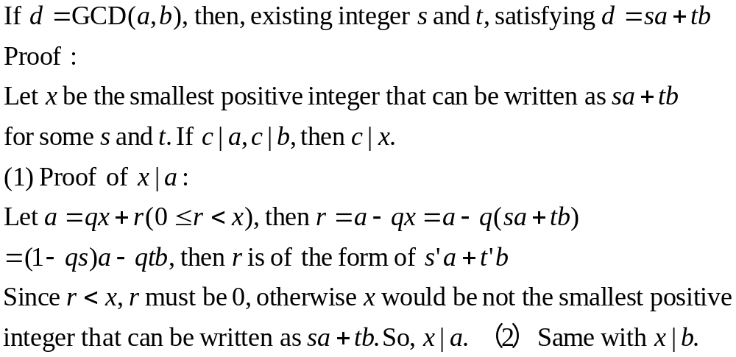
Proof by Contradiction - II

Slide 49
Dealing with Disjunction
Prove: n²=m² if and only if m=n or m= -n, where m,n are integers.
Proof:
Let: p: n²=m² , q: m=n, and r: m= -n.
Then, what is to be proved is: p⇔(q∨r)
← (premise is a disjunction)
(q∨r)⇒p is true when both q⇒p and r⇒p.
q⇒p: m=n → n²=m² ,
r⇒p: m= -n → n²=m² ,

Slide 50

Dealing with Disjunction (cont.)
→ (conclusion is a disjunction)
p⇒(q∨r) ≡ p⇒(~q⇒r), which can be proved by
p, ~q → r
that is: n²=m², m≠n → m= -n
Proof:
n²=m² → n²-m²=0 → (n+m)(n-m)=0
since m≠n, we have n-m ≠0, so, n+m=0
So, m= -n

Slide 51
Negating a Statement Using Counterexample
Prove or disprove:
∃x(A(x)∧B(x))⇔∃xA(x)∧∃xB(x)
Assume that:
  The domain is the set of all natural number
  A(x): x is odd
  B(x): x is even
Then, ∃xA(x)∧∃xB(x) = True, and ∃x(A(x)∧B(x)) = False. So, the above equivalence is disproved.

Slide 52
Loop Invariant
Computing the square of A(A is a positive integer):
FUNCTION SQ(A)
1. C ←0
2. D ←0
3. WHILE (D≠A)
a. C ←C +A
b. D ←D +1
4. RETURN(C)
END OF FUNCTION SQ
This is a loop, the body of which(statements a and b) will be executed repeatedly until D=A
C and D assume new values at the beginning of each new cycle of the loop. Let the value of C,D be C_{n} and D_{n} just after the nth cycle, with initial values of C₀ and D₀. Then the relation C_{n}=A×D_{n} will be invariate all the time.

Slide 53
Correctness of Function SQ
Computing the square of A(A is a positive integer):
FUNCTION SQ(A)
1. C ←0
2. D ←0
3. WHILE (D≠A)
a. C ←C +A
b. D ←D +1
4. RETURN(C)
END OF FUNCTION SQ
Termination: Since A is positive, D will be equal to A after finite cycles
It is easy to prove that the loop will terminat after exactly A cycles, which means that D=A at the end, so C=A² for any positive input A.
C_{n}=A×D_{n} for any positive integer n
Proof by induction:
According to the exucution procedure, C_{n}=C_{n-1}+A and D_{n}=D_{n-1}+1, but C_{n-1}=A×D_{n-1} by induction hypothesis. So C_{n}=(A×D_{n-1})+A=A×(D_{n-1}+1)=A×D_{n}

Slide 54
Exact Cover Problem
definition of exact cover of a set:
  Given a set A and a finite number of A: A₁,A₂,…A_{k}, a exact cover of A with respect to the A_{i}’s is a set S⊆ {A₁,A₂,…A_{k}} , satisfying:
    Any two sets in S are disjoint, and
    ∪S=A
  Mathematically, we call S a partition of A.
An example: A={a,b,c,d,e,f,g,h,i,j}; A₁={a,c,d}, A₂={a,b,e,f}, A₃={b,f,g}, A₄={d,h,i }, A₅={a,h,j}, A₆={e,h}, A₇={c,i,j}, A₈={i,j}
  The exact cover is {A₁, A₃, A₆, A₈ }

Slide 55
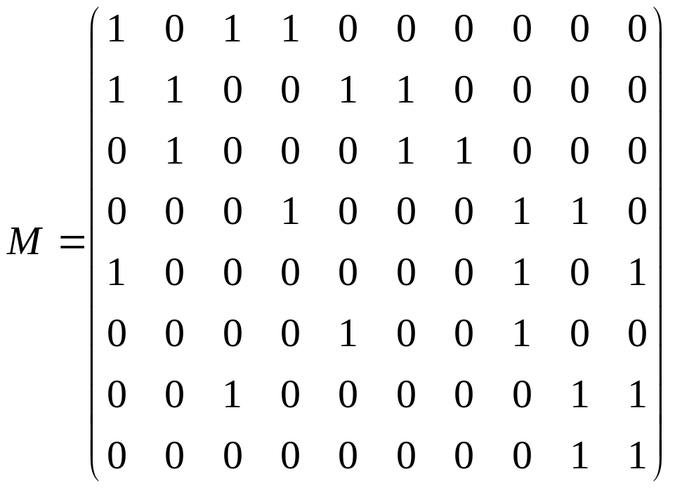

Representation Using Matrix
Let |A|=n, and there are m subsets for A_{i}’s, we can represent the input of exact cover problem as a m×n matrix, with each row for a A_{i} .
Solution:
Find a collection of rows of M: r₁, r₂,…r_{k}, satisfying:
r_{i}∧r_{j}=0 for 1≤i,j≤k, and
r₁∨r₂∨…∨r_{k}=1
where 0=[0 0 0 0 0 0 0 0 0 0]
1=[1 1 1 1 1 1 1 1 1 1]
and, ∧ is boolean product, ∨ is boolean sum

Slide 56
Algorithm X for Exact Cover
input: matrix A
Initialization: label the rows of A;
M=A; L={};
(1) If there is a column of 0’s in M, return “No solution”
(2) Otherwise:
  Choose the column c with the fewest 1’s;
  Choose a row r with a 1 in column c, L=L∪{r};
  Eliminate any row r_{i} having the property: r∧r_{i}≠0;
  Eliminate all columns in which r has a 1;
  Eliminate row r;
  If No row and column left, then output L, otherwise repeat (1) and (2) on resulted M;

Slide 57
Home Assignments
To be checked
  pp.55- 12, 15-16, 18, 28, 30, 32, 35
  pp.60- 6-7, 12-16, 24, 27-35
  pp.67- 8, 12, 18, 20, 22-24, 30
  pp.73- 20, 22, 26, 28, 30, 34, 36
  pp.78 20-25

